Slide 1
How to best use these slides…
View the PPT as a slide show
Then click through every step
Mouse clicks will advance the slide show
Left/right arrow keys move forward/backward
Mouse wheel scrolling moves forward/backward
When a question is posed, stop and think it through, try to answer it yourself before clicking
If you have questions, email me, ask in the Teams Student Center channel!

Slide 2
LESSON 6.6b
Solving Logarithmic Equations

Slide 3
Today you will:
Solve logarithmic equations.
Practice using English to describe math processes and equations

Slide 4
Core Vocabulary:
Change-of-Base Formula, p. 329
Previous:
Base of an exponent and of a logarithm

Slide 5

You will often see logarithmic equations in one of two forms
Log on each side, common base each side
Hey! This sound familiar?
Log & variable only on 1 side
Example: $\log_{2}{x}=\log_{2}{7}$
This is kind-of a duh…
What is the only way this can be true?
since the bases are the same…
…the log number has to be the same
So $x=7$
These are really simple…
Example: $\log_{3}{(x−4)}=4$
Convert to exponent form & do the simple algebra.
$\log_{3}{(x−4)}=4$
$x−4=3^{4}$
$x−4=81$
$x=85$

Slide 6
Solve (a) ln(4x $−$ 7) $=$ ln(x $+$ 5) and (b) log₂(5x $−$ 17) $=$ 3.
SOLUTION
Check
a. ln(4x $−$ 7) $=$ ln(x $+$ 5)
Write original equation.
?
ln(4 $\text{•}$ 4 $−$ 7) $=$ ln(4 $+$ 5)
4x $−$ 7 $=$ x $+$ 5
Property of Equality for Logarithmic Equations
?
3x $−$ 7 $=$ 5
Subtract x from each side.
ln($\text{1}\text{6}−$ 7) $=$ ln 9
✓
ln 9 $=$ ln 9
3x $=$ 12
Add 7 to each side.
x $=$ 4
Divide each side by 3.
Check
b. log₂(5x $−$ 17) $=$ 3
Write original equation.
5x $−$ 17 $=$ 2³
Convert to exponent form.
?
log₂(5 $\text{•}$ 5 $−$ 17) $=$ 3
5x $−$ 17 $=$ 8
Simplify right side
?
log₂(25 $−$ 17) $=$ 3
5x $=$ 25
Add 17 to each side.
?
log₂ 8 $=$ 3
x $=$ 5
Divide each side by 5.
✓
Because 2³ $=$ 8, log₂ 8 $=$ 3.

Slide 7
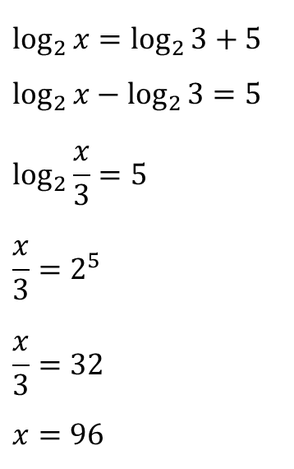
What if it is a bit messier?
Example: $\log_{2}{x}=\log_{2}{3+5}$
Log on each side same base, but more stuff tossed in…
Get all the logs on one side…
…and use the log properties
$\log_{b}{m}+\log_{b}{n}=\log_{b}{mn}$
$\log_{b}{m}−\log_{b}{n}=\log_{b}{\frac{m}{n}}$
$\log_{b}{m^{n}=n∙\log_{b}{m}}$
Let’s do it!
…get logs on same side
…$\log_{b}{m}−\log_{b}{n}=\log_{b}{\frac{m}{n}}$
…convert to exponent form
…simple algebra!
$$\log_{2}{x}=\log_{2}{3+5}$$
$$\log_{2}{x}−\log_{2}{3=5}$$
$$\log_{2}{\frac{x}{3}}=5$$
$$\frac{x}{3}=2^{5}$$
$$\frac{x}{3}=32$$
$$x=96$$

Slide 8
Solve log 2x $+$ log(x $−$ 5) $=$ 2.
SOLUTION
Check
log 2x $+$ log(x $−$ 5) $=$ 2
Write original equation.
?
log [2x(x $−$ 5)] $=$ 2
Product Property of Logarithms
log(2 $\text{•}$ 10) $+$ log(10 $−$ 5) $=$ 2
2x(x $−$ 5) $=$ 100
Convert to exponent using base 10.
?
log 20 $+$ log 5 $=$ 2
2x² $−$ 10x $=$ 100
?
Distributive Property
log 100 $=$ 2
2x² $−$ 10x $−$ 100 $=$ 0
Write in standard form.
✓
2 $=$ 2
x² $−$ 5x $−$ 50 $=$ 0
Divide each side by 2.
(x $−$ 10)(x $+$5) $=$ 0
Factor.
?
log[2 $\text{•}$ ($−$5)] $+$ log($−$5 $−$ 5) $=$ 2
x $=$ 10 or x $=$ $−$5
Zero-Product Property
?
log($−$10) $+$ log($−$10) $=$ 2
Because log($−$10) is not defined,
$−$5 is not a solution.
The apparent solution x $=$ $−$5 is extraneous. So, the only solution is x $=$ 10.
✘

Slide 9
Homework
Pg 338, #21-46

